Slide 1
COMS 4111: Introduction to Databases Lecture 6: Self-JOIN, Views, Some Relationship Patterns, DDL
Dr. Donald F. Ferguson
dff9@columbia.edu

Slide 2
Associative Entity versus Weak Entity

Slide 3
Backup

Slide 4
Contents

Slide 5
Contents
Introduction: Questions? Comments?
Combining Relations/Tables
Set Operations
Join
Associative Entities.
Relevance to Assignment 2

Slide 6
Introduction Questions? Comments?

Slide 7
Combining Tables

Slide 8
Introduction

Slide 9
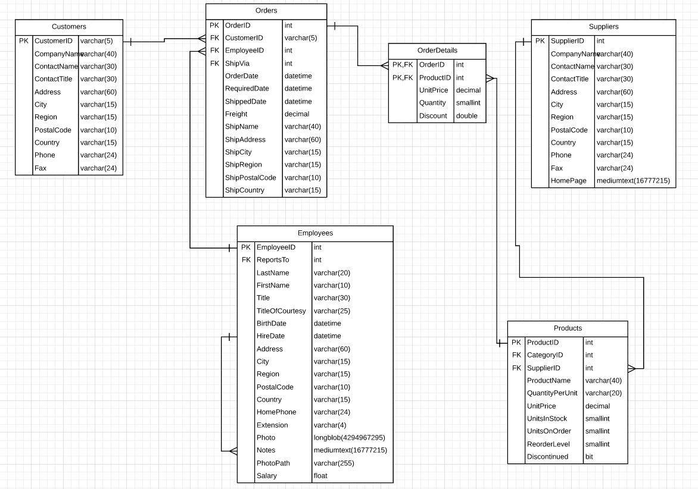
Data Model
Some user stories/use cases require information from multiple tables. For example,
Which products has a customer ordered?
Which employees have managed a customer’s orders?
How many orders has each employee managed?

Slide 10
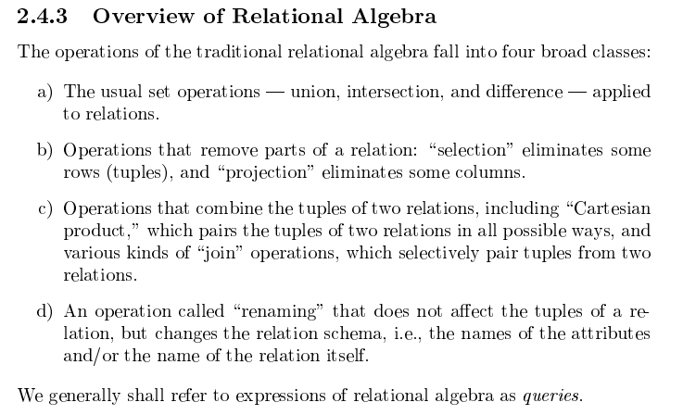
(Molina et al.)

Slide 11
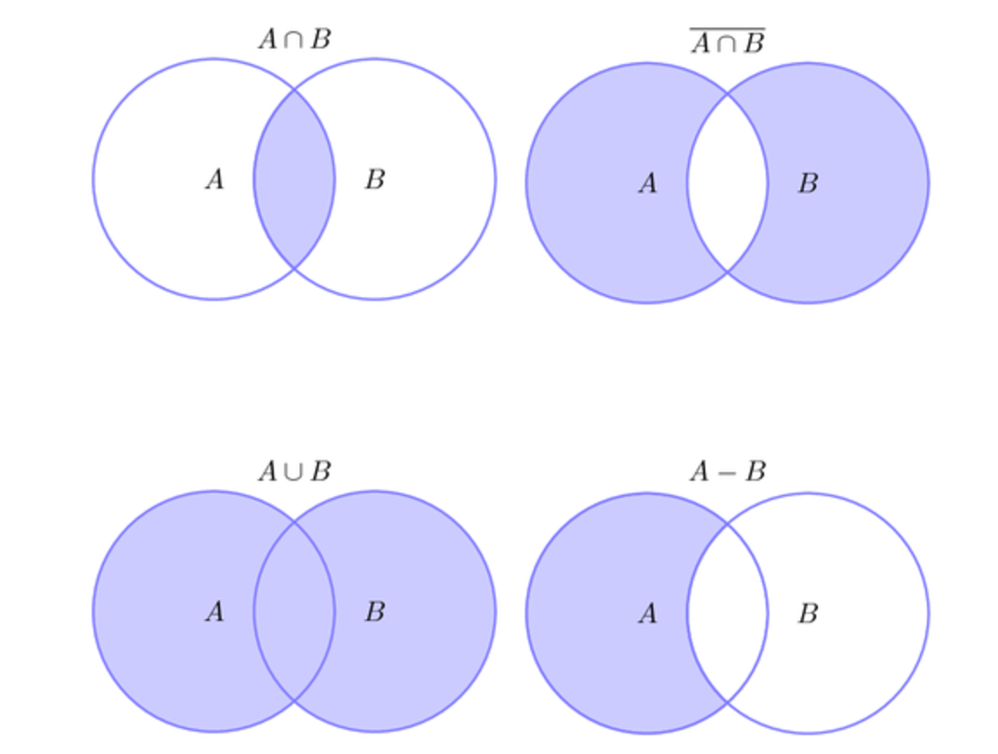
Common Set Operations
The canonical set operations are
Intersection
Union
Difference
Symmetric Difference
Cartesian Product
The corresponding relational (SQL) operations are
INTERSECT
UNION
EXCEPT
(CROSS) JOIN

Slide 12
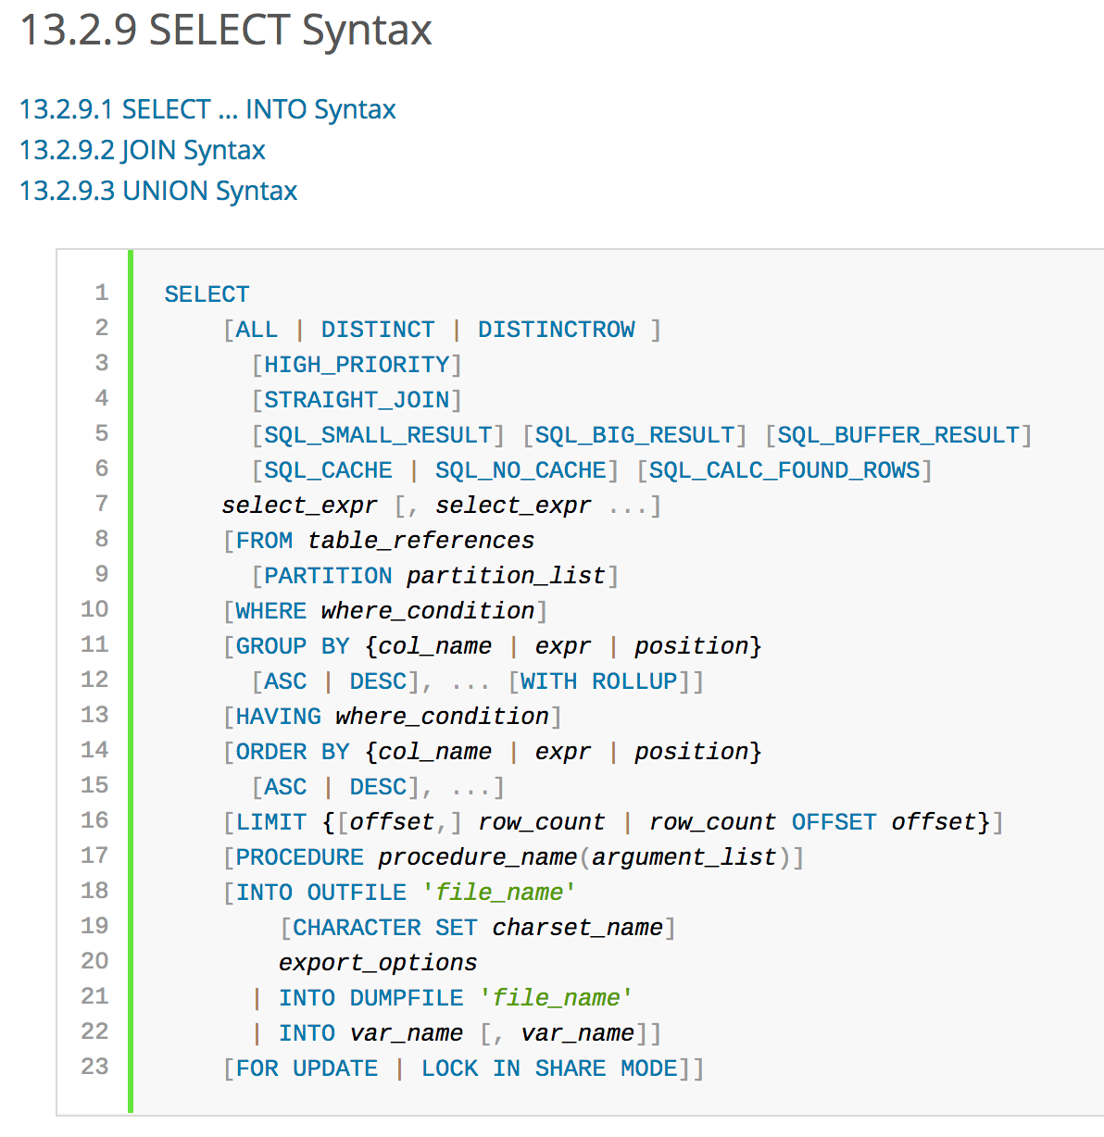
MySQL (Set) Operations
SELECT is the operation for “reading” tuples ➔ the Set Operations are “inside” a SELECT. SELECT <columns> FROM (A <SET OPERATION> B WHERE <Predicate>
But, many SQL engines including MySQL
Only support
JOIN
UNION
Because you can implement
EXCEPT, INTERSECT, etc.
By combining operations algebraically
And JOIN combined with SUB SELECT is more powerful, and covers many more common use cases..

Slide 13
JOIN

Slide 14
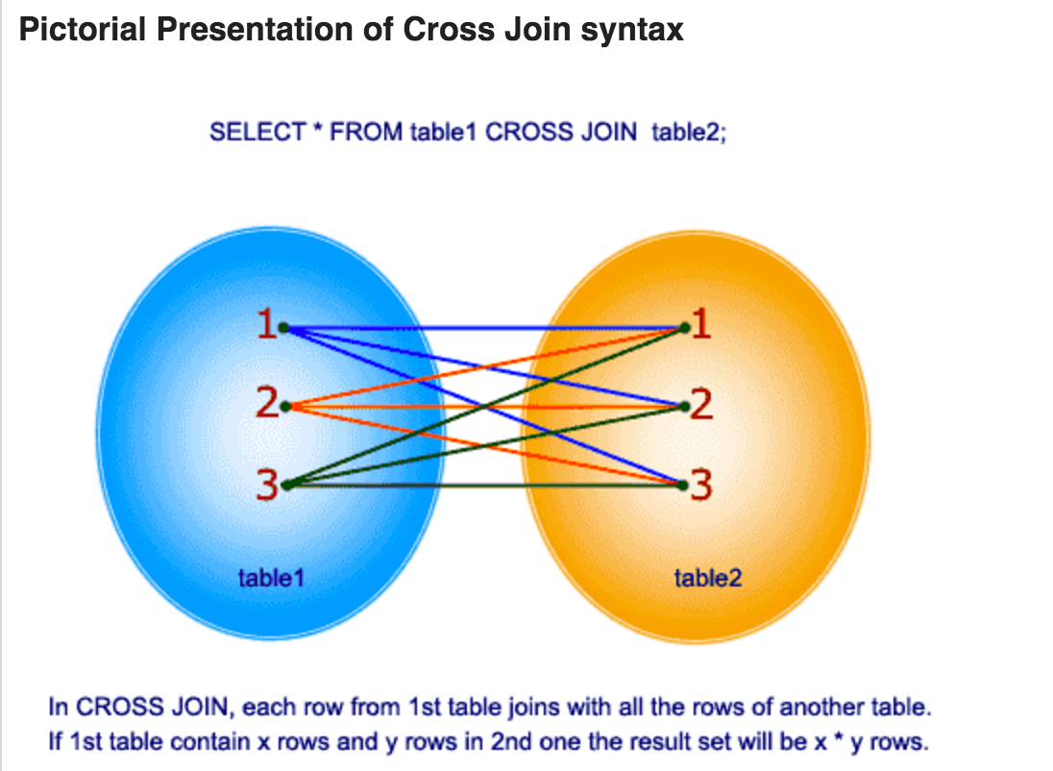
CROSS JOIN is the Foundation
If I have two relational schemas (relations)
R(a,b)
S(c,d,e)
The CROSS JOIN is
Schema X(a,b,c,d,e)
For every pair of
(a,b) in R
(c,d,e) in S

Slide 15
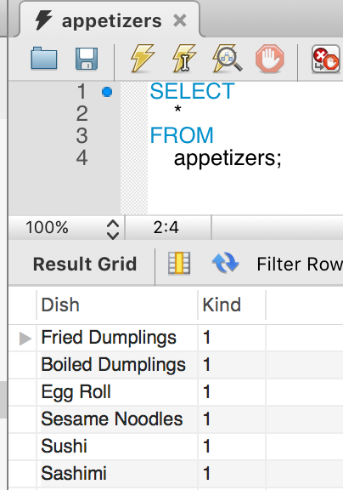
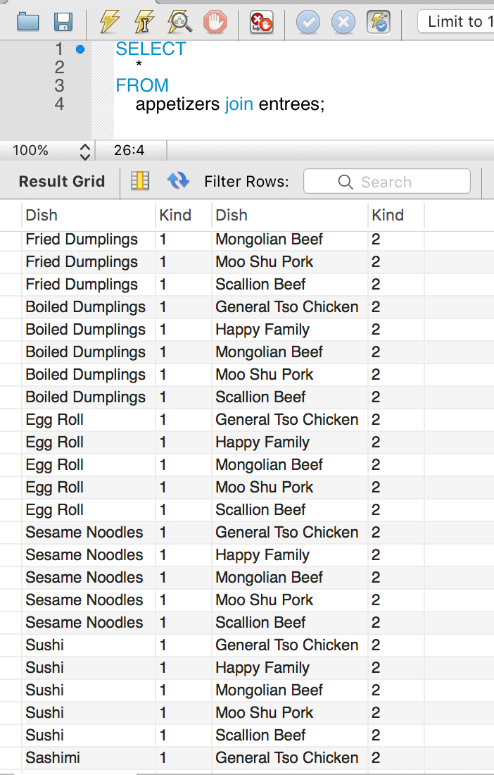
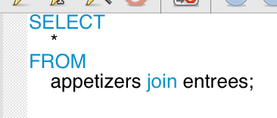
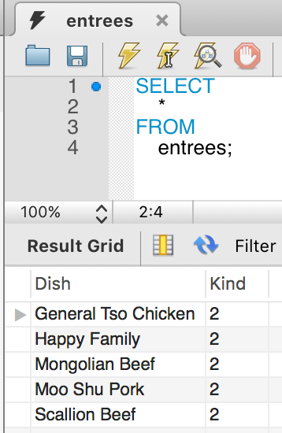
Lunch Special is One from Column A and One from Column B

Slide 16
Lunch Special is One from Column A and One from Column B
I apologize if this is culturally insensitive.
This was a very common example when I went to college
But a lot of stuff from 1982 is probably insensitive.
I apologize if I gave offense.
This example is easier to cognitively process than ones using a, b, a1, a2, etc.

Slide 17
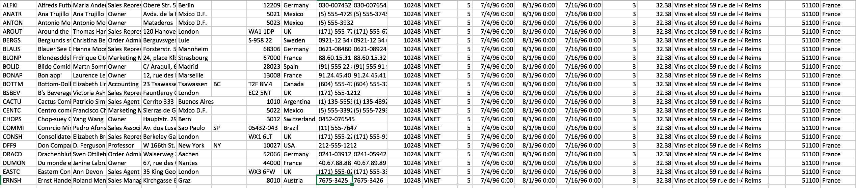
Northwind Database
SELECT * FROM Customers JOIN Orders;
What does this even mean? For example, the first tuple has
(ALFKI, Germany, VINET, France)
(Berlin, France)
Can this help us find customers’ orders?

Slide 18
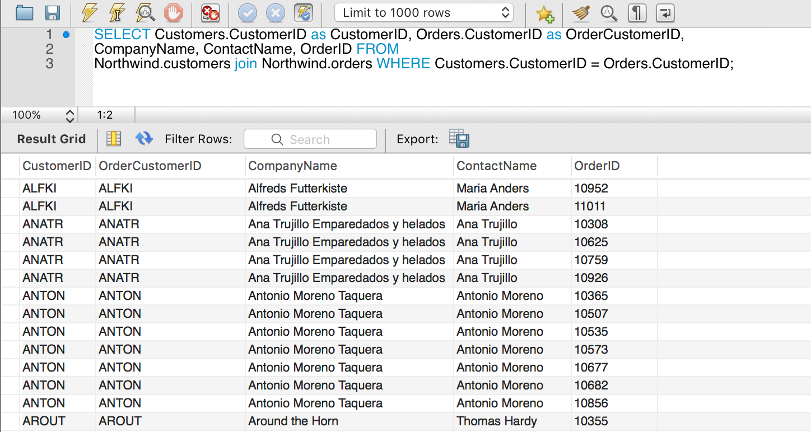
Sure! Make all Combinations and then SELECT the Ones that Make Sense.
I have to be clear about “which” table when they share column names.
Identify: Table.Column.
Rename: Table.Column as X.
This approach still seems
Inefficient.
Kind of weird.
Why am I
Matching Customers with other Customers’ orders?
And then picking the combinations that are not nutty?

Slide 19
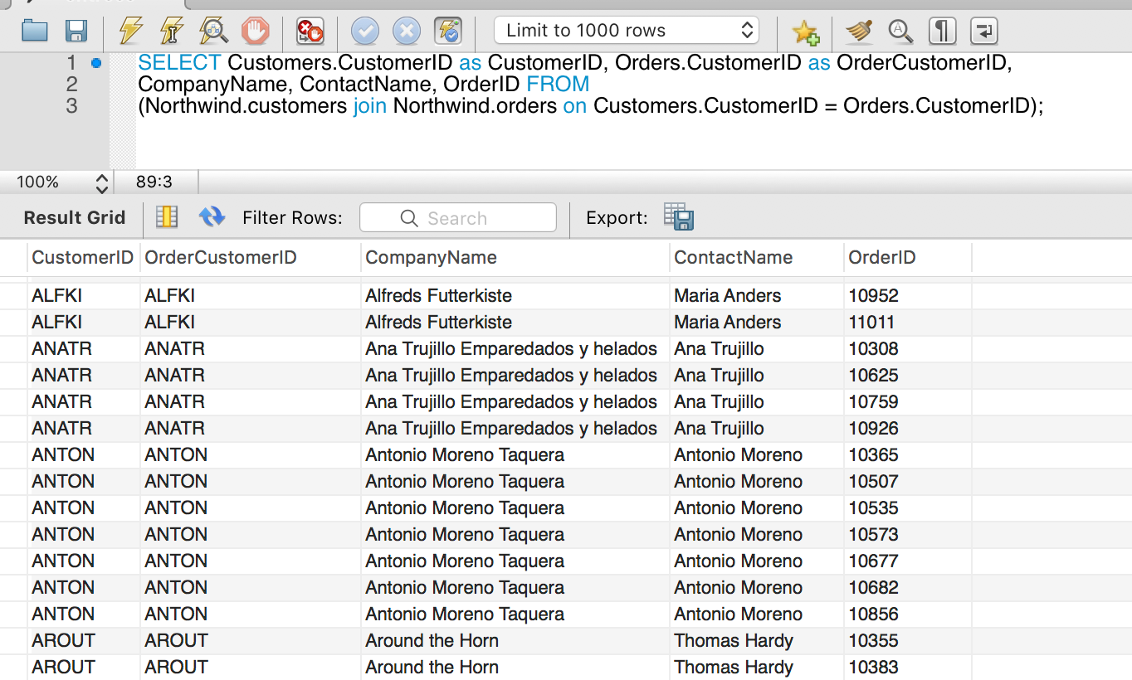
JOIN – Just Match the Non-Nutty Ones!
If
N(O) is no. of Orders and
N(C) is no. of Customers
This
Only produces a table of size N(O)
And never produces a table of size N(O) * N(C)
Only the non-nutty ones are ever under consideration.

Slide 20
JOIN – Just Match the Non-Nutty Ones!
If
N(O) is no. of Orders and
N(C) is no. of Customers
This
Only produces a table of size N(O)
And never produces a table of size N(O) * N(C)
Only the non-nutty ones are ever under consideration.

Slide 21
JOIN – Just Match the Non-Nutty Ones!
If
N(O) is no. of Orders and
N(C) is no. of Customers
This
Only produces a table of size N(O)
And never produces a table of size N(O) * N(C)
Only the non-nutty ones are ever under consideration.
You do not have to do this if the column is already indexed → Already sorted

Slide 22
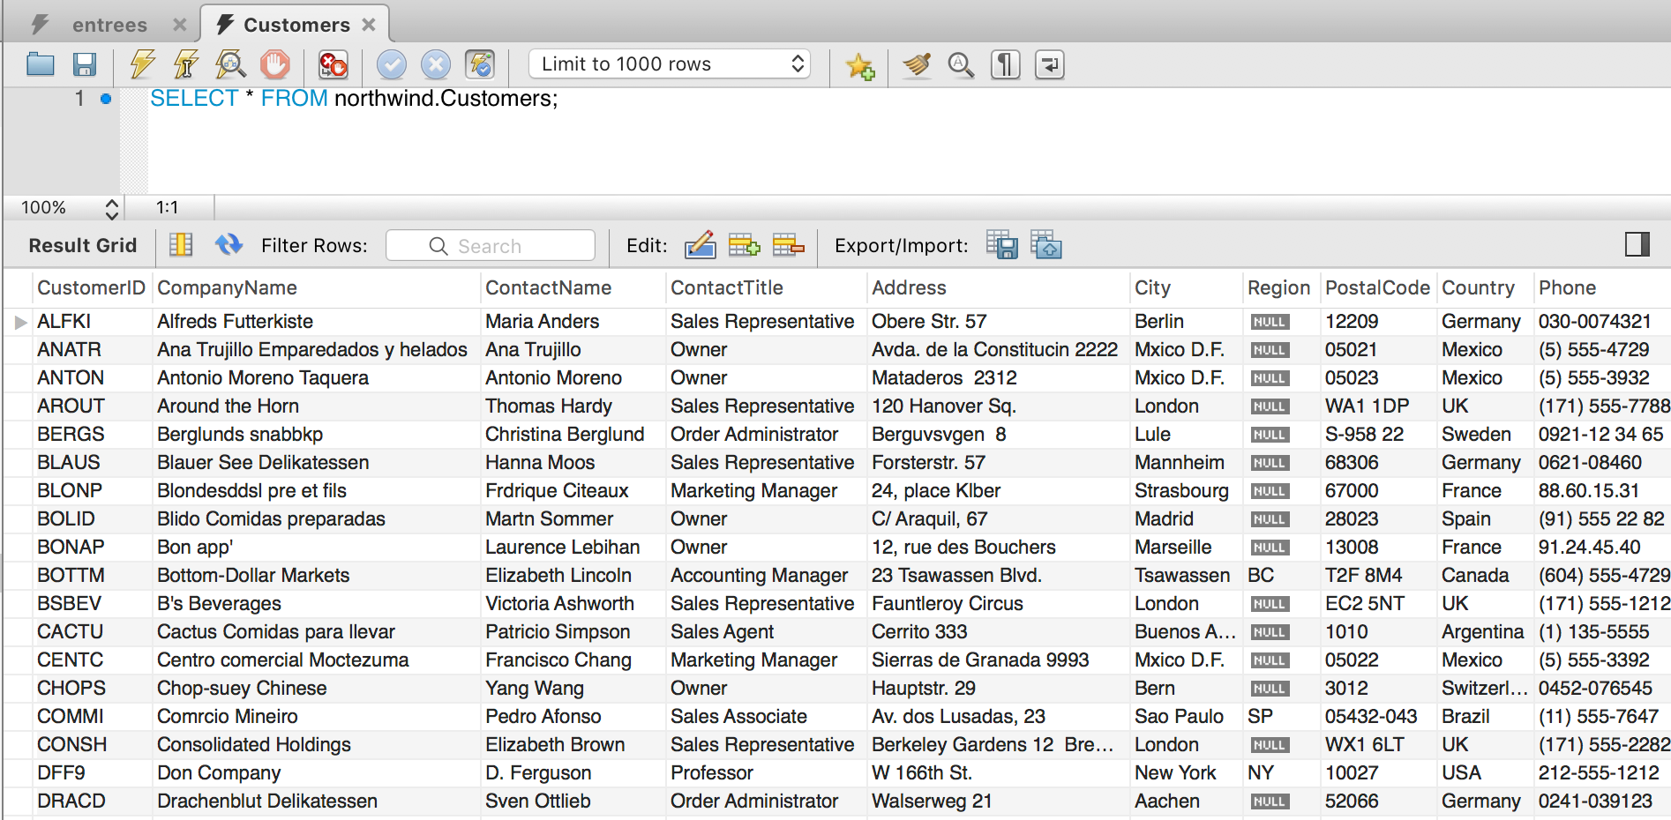
Customers

Slide 23
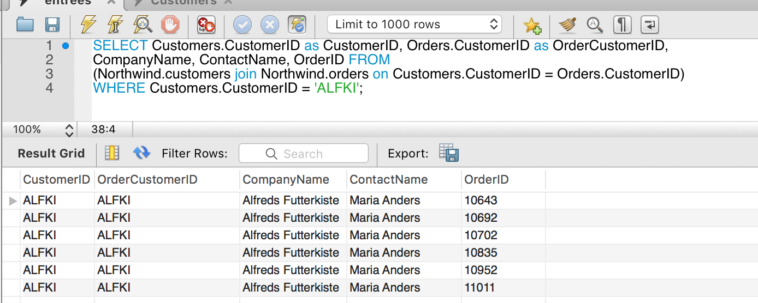
Let’s Get a Specific Customers Orders

Slide 24
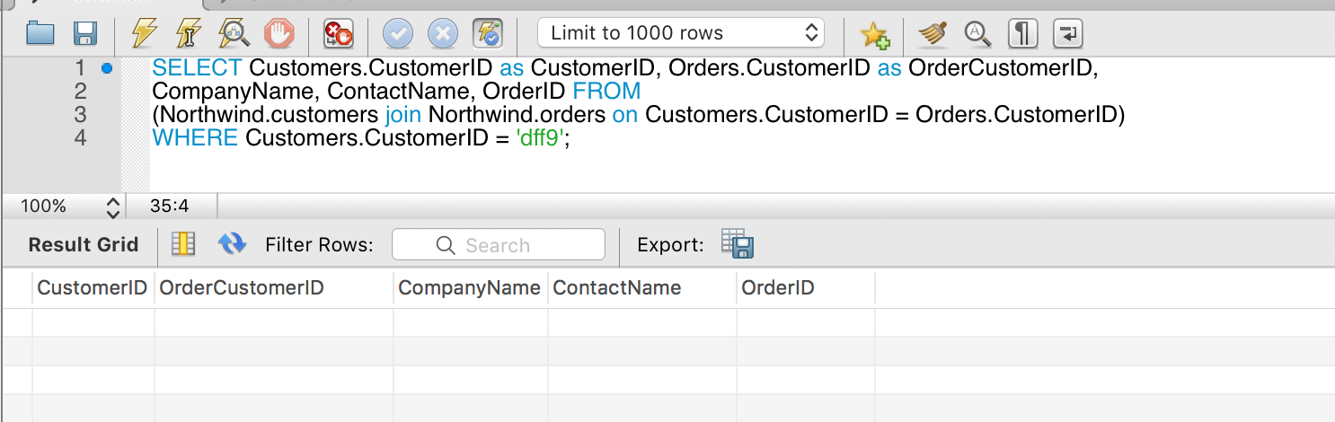
Let’s Get Don’s Orders
OK. Don does not have any orders.
But, there is a Customer DFF9.
So, I expected something like (dff9, null, Don Company, D. Ferguson, null). I expected to see the stuff that DOES exist.

Slide 25
(INNER) JOIN

Slide 26
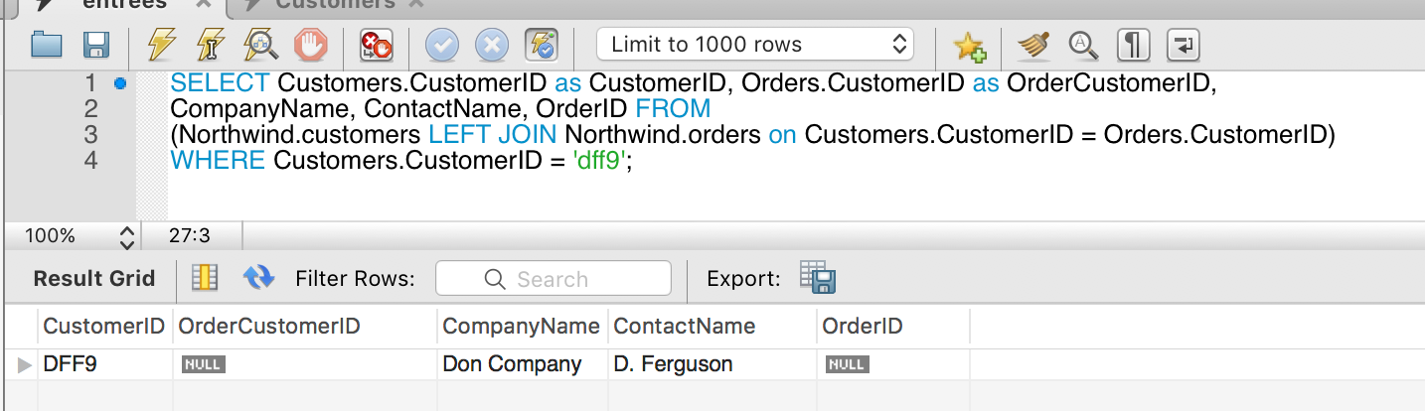
LEFT (OUTTER) JOIN
This is a LEFT (OUTTER) JOIN
All of the left (1st) table, with null columns from the right table if there is no match.
All of the cross-product JOIN tuples when there is a match.
There is a corresponding concept of RIGHT (OUTTER) JOIN.

Slide 27
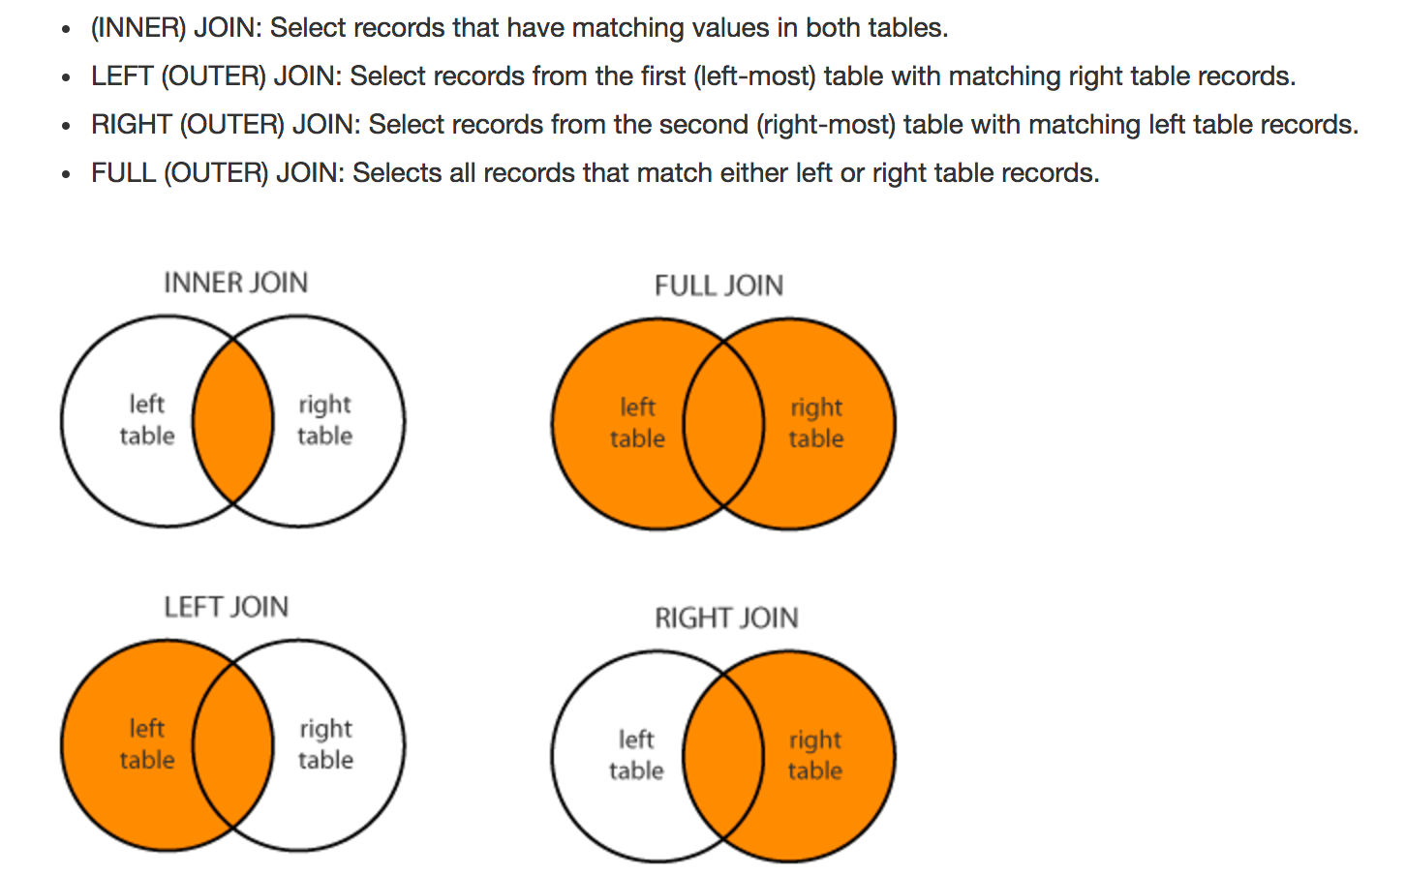
Types of JOIN (http://www.dofactory.com/sql/join)

Slide 28
More Complex Types of JOIN
You can achieve any set theory operations by correctly applying
FULL
OUTTER
INNER
LEFT
RIGHT
And there WHERE clause.
We will go through other examples later, but also use SUB-SELECT.

Slide 29
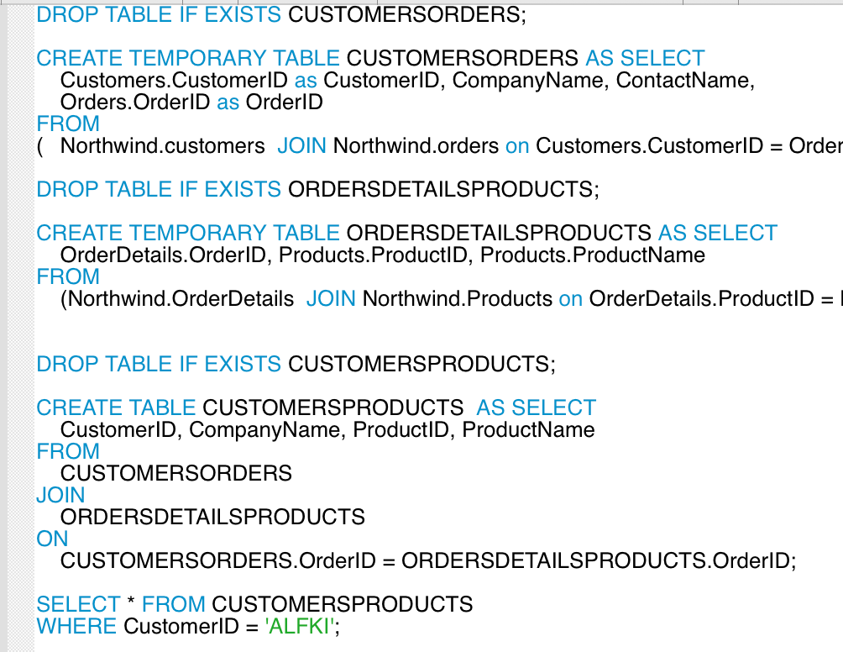
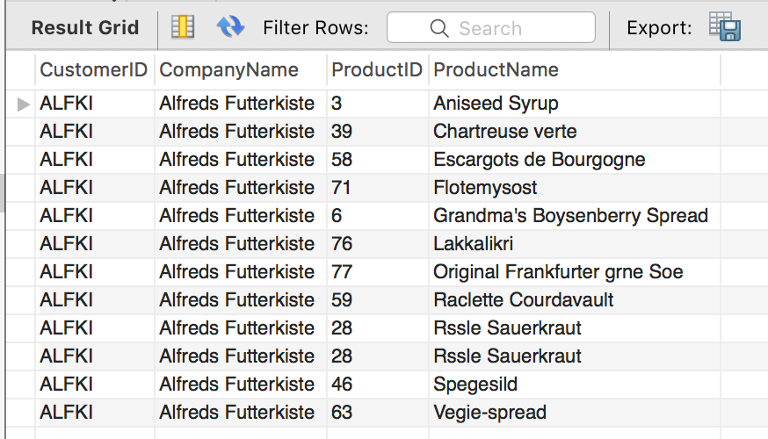
Find All Products ALFKI Ordered

Slide 30
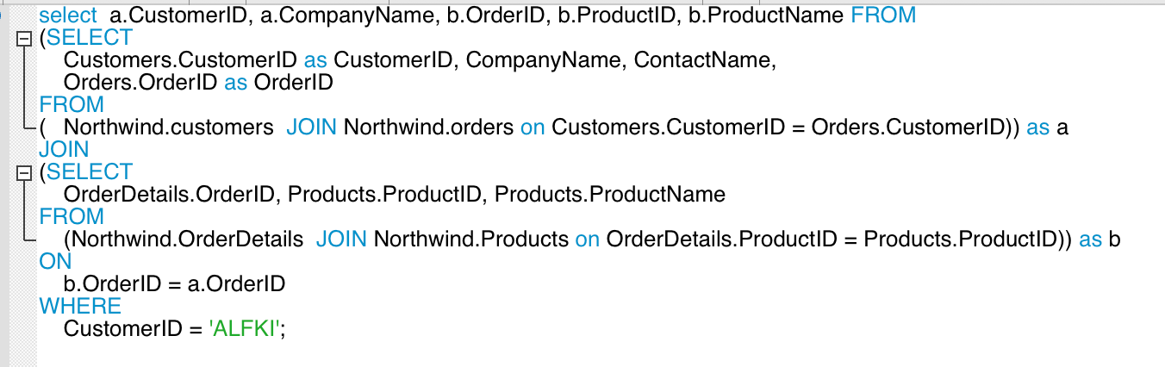
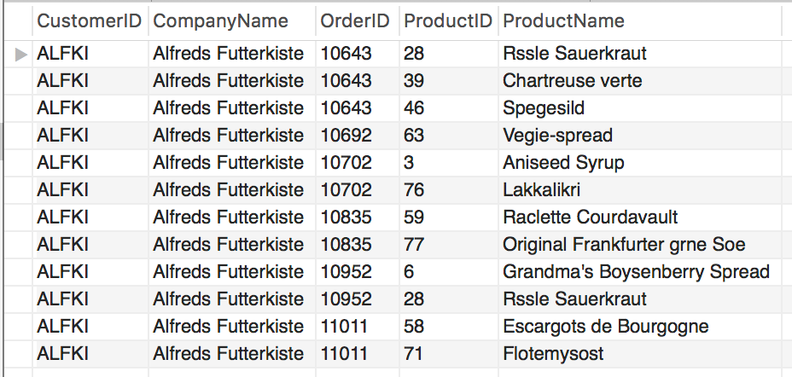
Without Temporary Tables

Slide 31
Temporary Tables I use temporary tables for two scenarios.
Development/debugging simplification
The RDB engine implicitly creates temporary tables for intermediate results produced during complex query processing.
I find that
Writing the smaller, individual queries to produce explicit temporary tables.
Then combining the temporary tables into more complex temporary tables.
Until achieving the desired table for SELECT/PROJECT/numerical operations.
When confident, merging into the complex query.
Simplifies development and testing.
Running several different analysis queries against a common derived table.
Instead of each analysis query recreating the intermediate table.
I create it once, and then run the analysis queries again it.
Temporary tables
Are not standard and support varies.
Just simplifies CREATE … DROP by automatically DROPping at disconnect.

Slide 32
Associative Entity

Slide 33
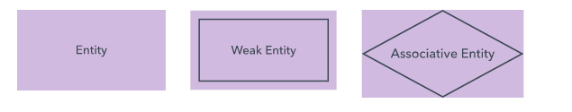
Some Additional Concepts (Chen Notation)
Entity: Well, we know what this means.
“Weak Entity:”
An entity whose existence depends on/is only defined relative to another entity.
OrderDetails is an example.
”Associative Entity:”
An associative entity is an entity (e.g. has attributes) AND
Represents a relationship between sets of entities.
Usually used for many-to-many AND/OR the relationships has properties independent of the related entities.

Slide 34
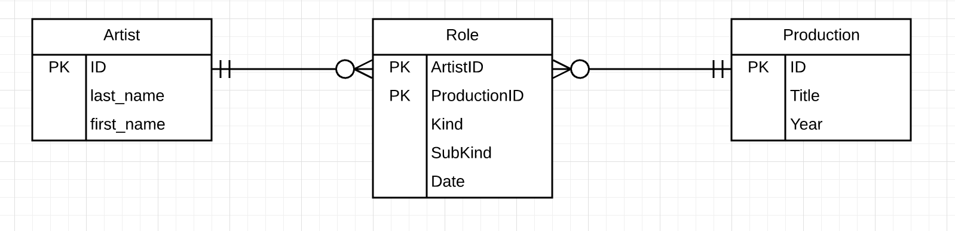
Canonical Example
This a design pattern.
Better pattern for some scenarios.
Base Entities
Artist, e.g. Tom Hanks, Clint Eastwood, …
Production, e.g. movie, mini-series, TV series, …
Relationship/Association
Kind: director, actor, producer, …
Date: Sometimes a movie changes directors, actors, etc.
An Artist may have more than one role, e.g. director and actor.

Slide 35
Assignment 2

Slide 36
Assignment 2
Define (data model) and implement (DDL) entities and relationships for
Students
Faculty
Course
Section (of course)
Enrollment (enrolled, waitlisted)
This should include
Modeling and implementing required/optional relationships, cardinality, etc. You can use whatever notation you want as long as clear.
Implementing constraints, except for CHECK.
Define a set of interesting user stories and show supporting SQL queries, data model chosen and constraints chosen.
Populate with sample/test data.
Submission details
Date/Time: 29-Sep-2017, 23:59:59 EDT.
Data Model diagrams, with 3-4 pages of text explaining the model design choices, etc.
DDL
User stories you chose, supporting SQL statements and screen shot/recording of execution.

Slide 37
Assignment 2 – Observations
A lot of the interesting user stories require JOIN
“As a student, I want to see which courses a professor has taught.”
“As a professor, I want to see which courses students in my class have taken.”
“As an administrator, I want to know what percentage of students take course 1, course 2 and course 3.”
“As a professor I want to know which TA applicants have previously take a course.”
”As an administrator, I want to know average section enrollment based on course time of day.”
There are interesting questions about relationships
”Can a course not have an instructor?”
“Is the relationship between student and section, student and course, or both?”
“A student may have multiple relationships with a course, e.g. TA and enrolled.”

